Slide 1


Design & Ethics

Slide 2
There are professions more harmful than industrial design but only a few of them. Advertising design, in persuading people to buy things they don`t need, with money they don`t have, in order to impress others who don`t care, is probably the phoniest field in existence today.
- Victor Papanek | Design for the Real World

Slide 3
DESIGN HAS THE POWER TO INFLUENCE. IT THEREFORE COMES WITH GREAT RESPONSIBILITY.
NUDGE, SWITCH, HOOK, GAMIFICATION, DESIGN WITH INTENT etc. ARE JUST SOME TOOLS TO EFFECT BEHAVIORS.

Slide 4
THAT’S WHERE HUMAN-CENTERED DESIGN AIMS TO BE DIFFERENT.

Slide 5
BE GUIDED BY THESE QUALITIES..
EMPATHY
The quality of understanding someone’s joys, pains and anxieties without judging them. The commitment to making time and effort understand someone’s context first hand.
EXPERIENCE CENTERED
The quality of thinking of solutions as end to end journeys that people go through, and a desire to elevate moments.
PARTICIPATORY
The quality of including diverse opinions and skills in the process of identifying, building and assessing solutions.

Slide 6


FINANCIAL INNOVATION LAB | BOOTCAMP TWO
SOME TYPICAL ETHICAL DILEMMAS
Where is the line between collecting data and breaching privacy and trust?
Where is the line between building habitual use and encouraging user addiction?
Where is the line between letting users customise experience (like notifications), and providing standard non-negotiables?
Where is the line between revenue generation and encouraging consumers to spend their time, energy and money on things they may not always need?
THESE ARE JUST SOME QUESTIONS...
Notes:
https://2017.ind.ie/ethical-design/

Slide 7
HOW DOES ONE KNOW IF ITS A DILEMMA OR NOT?

Slide 8
Ethical Decision Matrix
Good for User | Tailor for Business | Adopt Immediately
Bad for User | Avoid Immediately | Tailor for User
 | Bad for Business | Good for Business
CONSIDER THIS SIMPLE FRAMEWORK NEXT TIME YOU ARE FACED WITH A CHALLENGE
Notes:
https://2017.ind.ie/ethical-design/

Slide 9
WHERE AND WHEN HAVE YOU FELT AN ETHICAL DILEMMA IN YOUR BUSINESS OR ORGANISATION?
HOW DID YOU TACKLE IT? WHAT CAN WE ALL LEARN FROM YOUR EXPERIENCES?

Slide 10
SOME OTHER FRAMEWORKS & RESOURCES

Slide 11
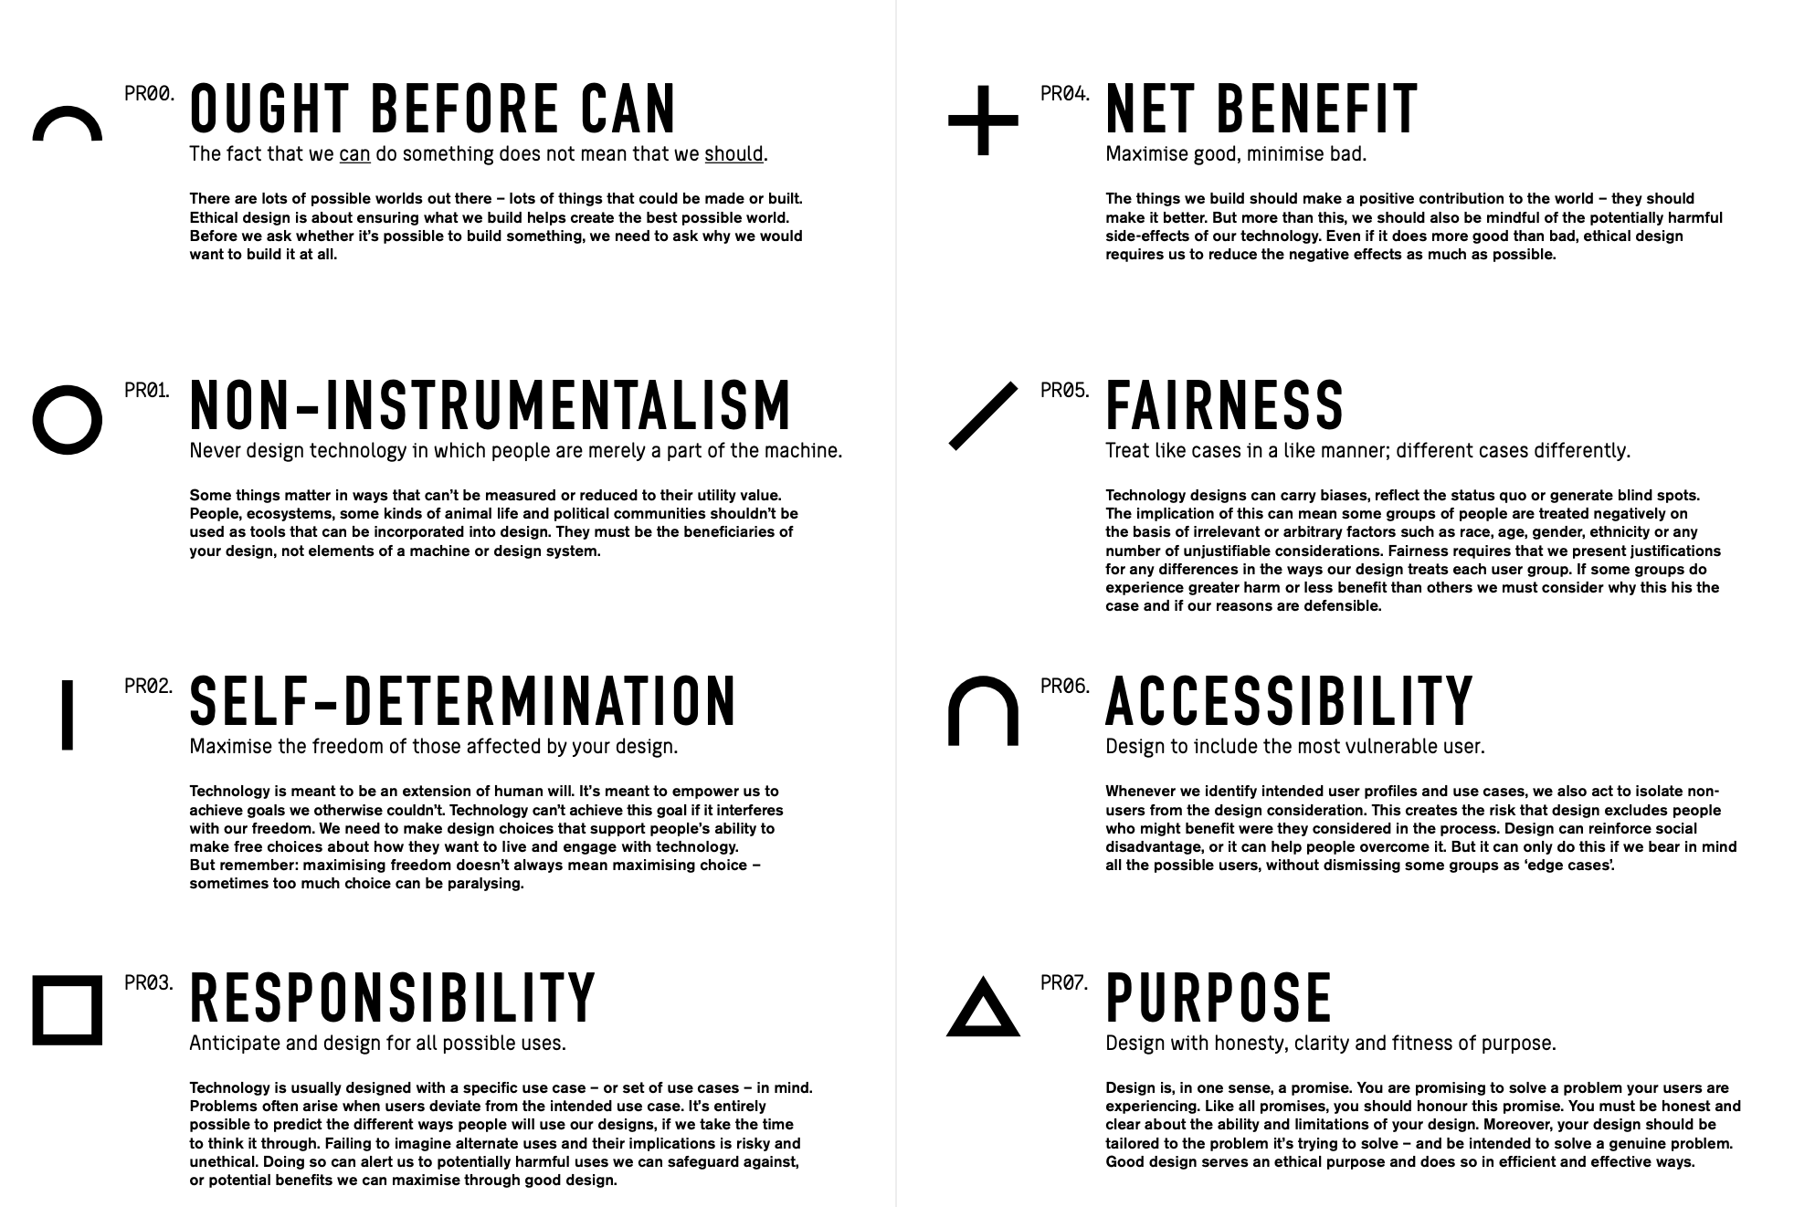
Source: https://ethics.org.au/ethical-by-design/
Notes:
https://2017.ind.ie/ethical-design/

Slide 12
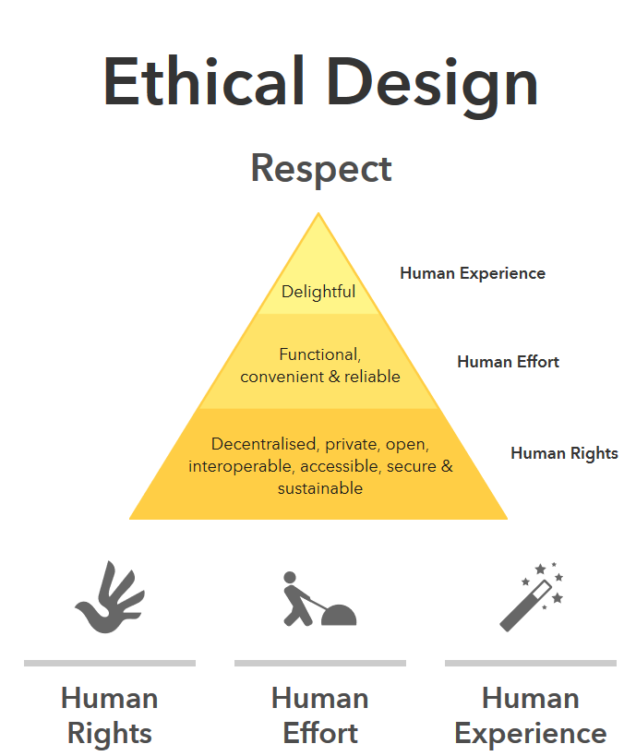
Source: https://2017.ind.ie/ethical-design/
Notes:
https://2017.ind.ie/ethical-design/

